Slide 1
High-Performance Thermodynamic Property Computation using Parallelization and Optimization Techniques
Team 11
Khasan Akhmadiev
Aikun Bexultanova

Slide 2
Introduction
Purpose of the Project:
To explore and implement high-performance Python methods for computational tasks
Chosen Task: Solving Thermodynamic Equations efficiently
Why High Performance?
Standard Python can be slow for computationally heavy tasks
Utilizing optimized methods can save time and resources

Slide 3
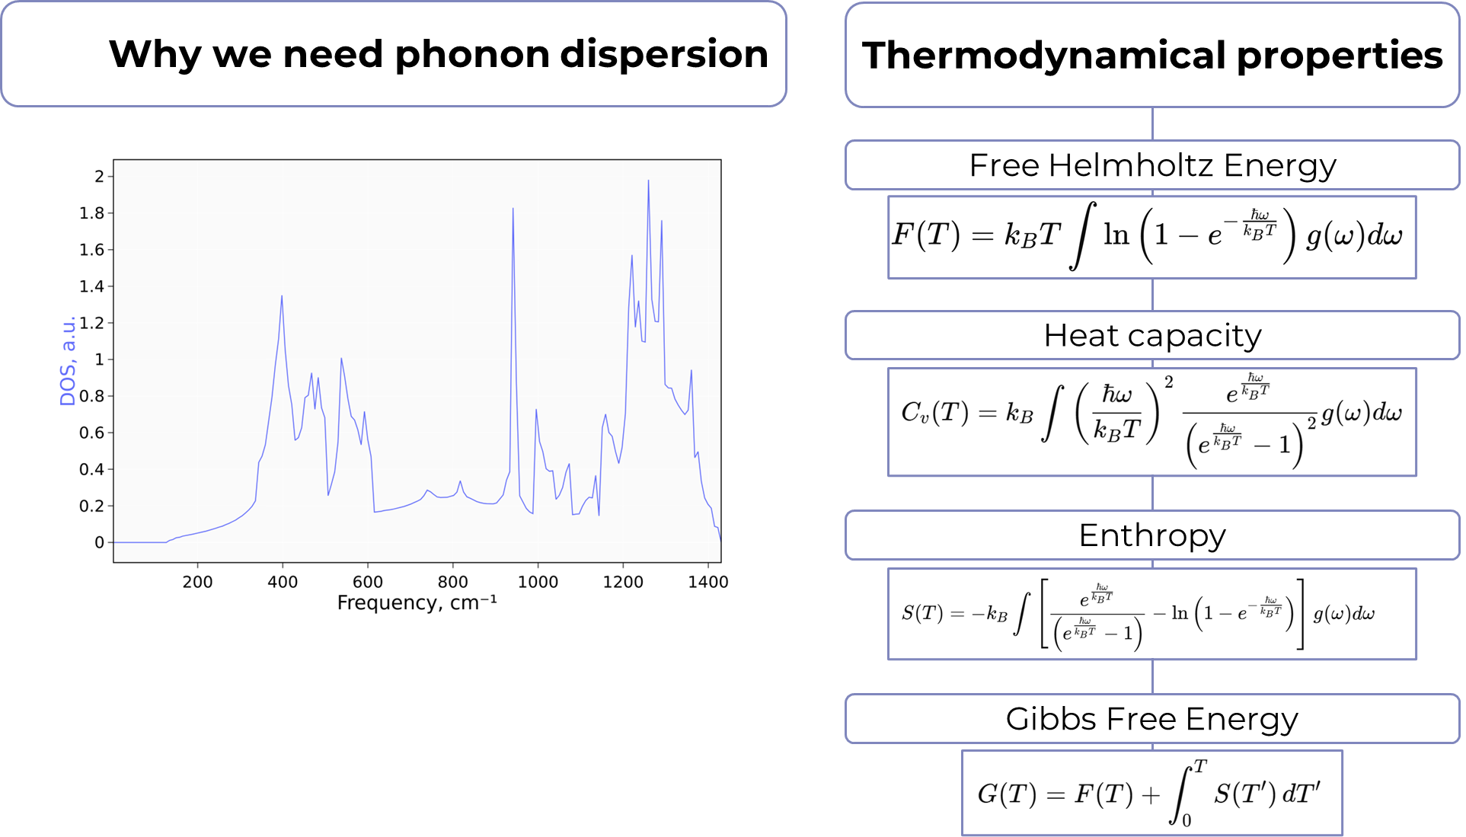
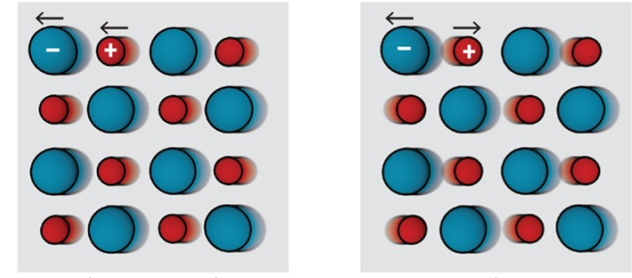

Slide 4
Tools and Libraries Used
NumPy: Optimized numerical computations using vectorized operations.
Numba: JIT (Just-In-Time) compiler for Python functions.
CuPy: library for GPU-accelerated computing with Python.
Multiprocessing: Parallel execution of tasks.
MPI: portable message-passing standard designed to function on parallel computing architectures.
Benchmarking: compare execution time for each task

Slide 5
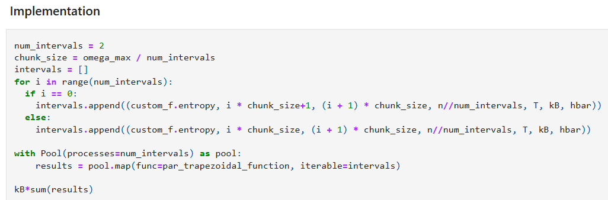
Enthropy. Multiprocessing

Slide 6
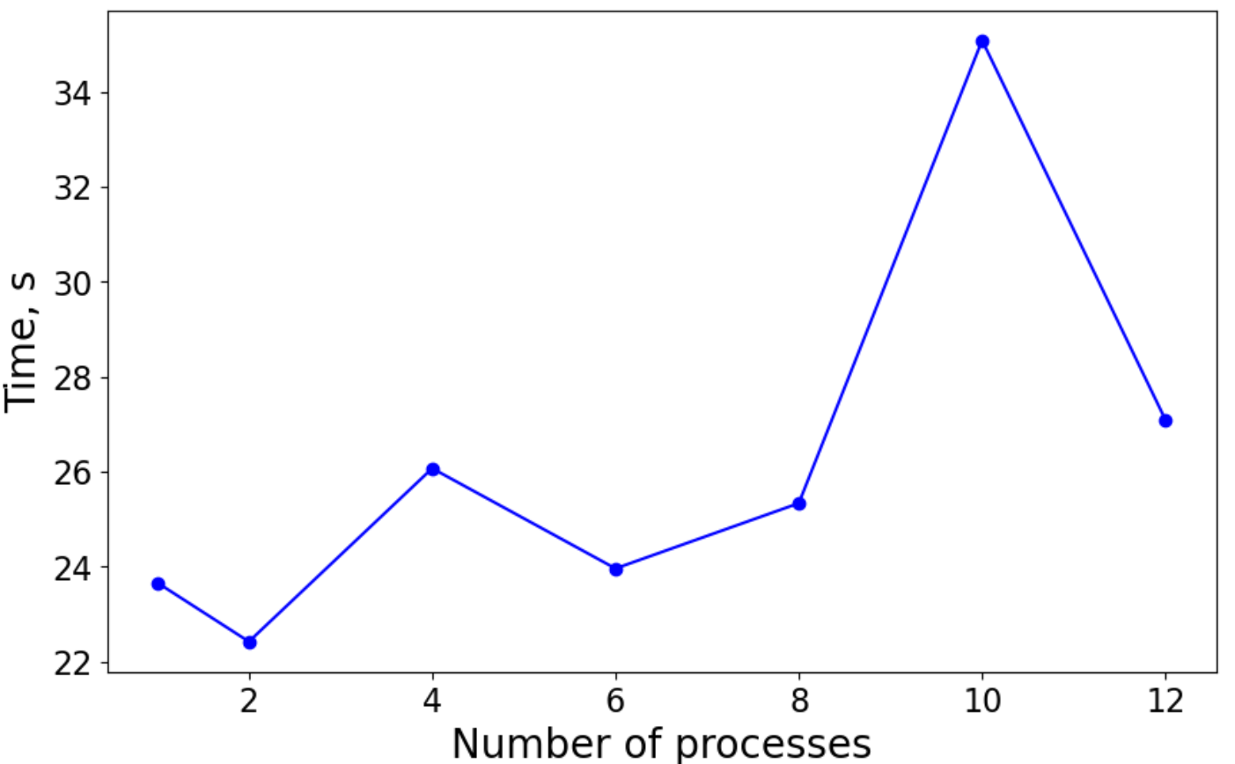
Entropy evaluation

Slide 7
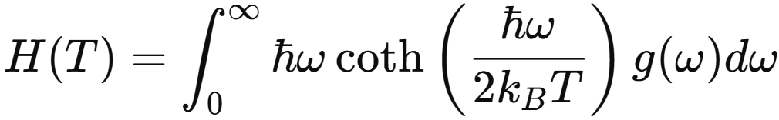
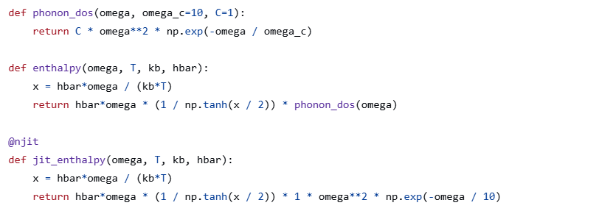
Enthalpy. Numba
Regular & numba implementation

Slide 8
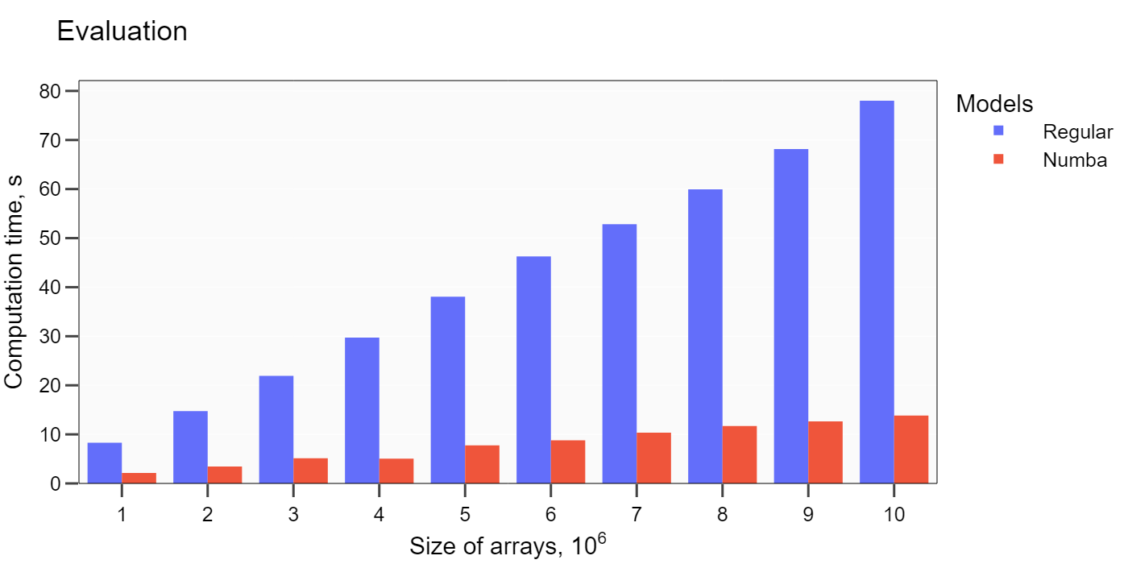
Enthalpy evaluation

Slide 9

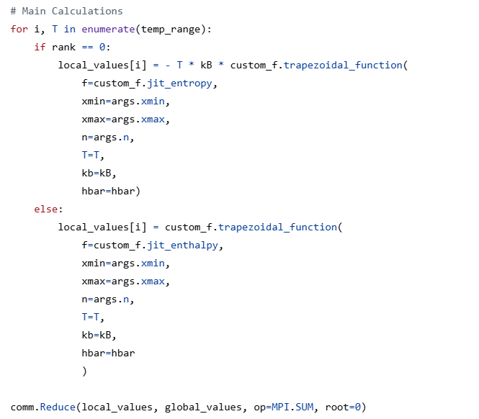
Gibbs energy. MPI

Slide 10
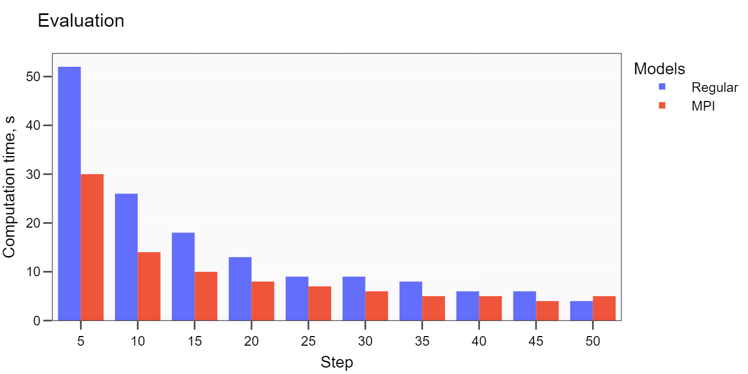
Gibbs energy evaluation

Slide 11
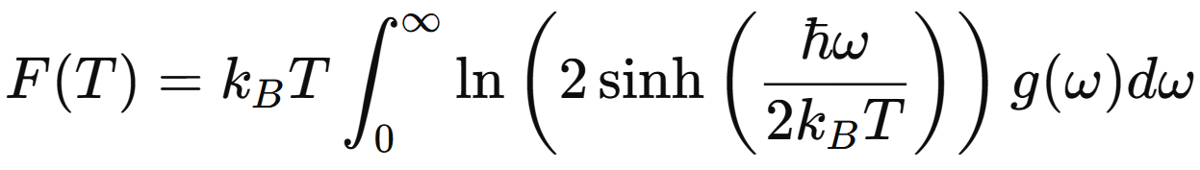
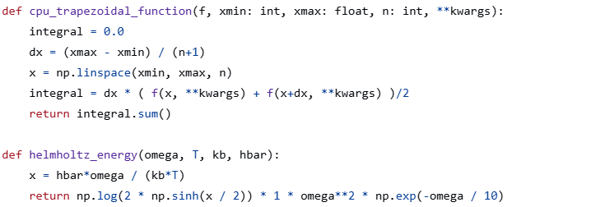
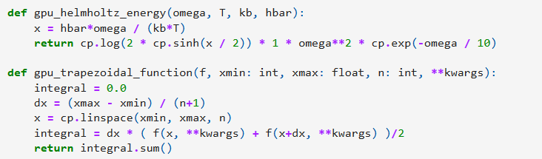
Helmholtz Free energy. GPU

Slide 12
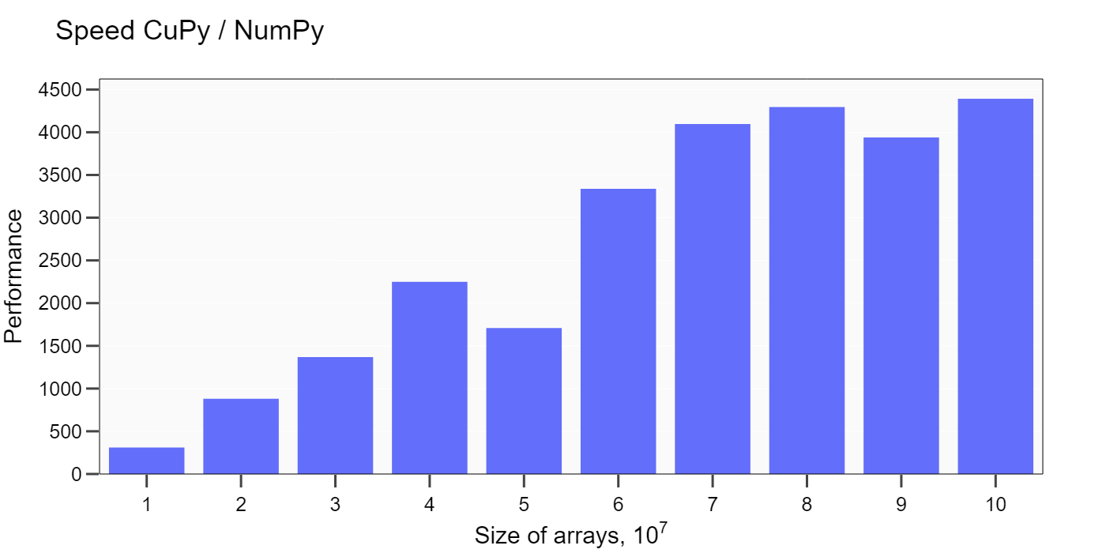
Evaluation

